Slide 1
Automatic Dome Control System Team: The Logic League

Slide 2
AGENDA
Abstract
Introduction
Proposed Methodology
Advantages
Getting Real-Time Data From API
System Design
Working Mechanism
Software Implementation
Hardware Implementation
Results
Future Enhancements
Conclusion

Slide 3
ABSTRACT
The Automatic Dome Control System automates dome operations like opening, closing, and adjusting orientation based on real-time environmental conditions. Equipped with sensors (temperature, humidity, rain, and light) and actuators, it dynamically responds to weather changes, ensuring protection, ventilation, and optimal light exposure.
Using microcontrollers or IoT-based systems, the dome can be monitored and controlled remotely, improving energy efficiency and reducing manual effort. This system is ideal for observatories, smart greenhouses, and climate-controlled buildings, enhancing safety and operational convenience.

Slide 4
INTRODUCTION
The Automatic Dome Control System is a modern solution designed to automate and optimize the operation of dome structures. It eliminates manual intervention by integrating sensors and actuators to respond intelligently to environmental changes.
Purpose: To control dome opening, closing, and orientation for optimal ventilation, light exposure, and protection.
Key Features:
Automatic response to temperature, humidity, rain, and light conditions.
Integration of microcontrollers or IoT-based systems for remote monitoring and control.
Applications: Widely used in observatories, smart greenhouses, and climate-controlled buildings.
This system enhances efficiency, safety, and convenience, making it ideal for modern automation needs.

Slide 5
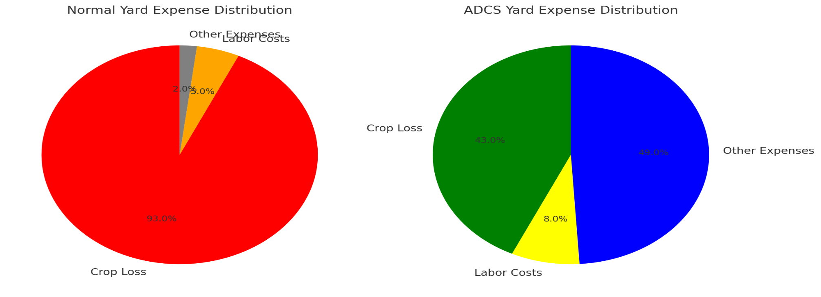
STATISTICS
Reduction in Crop Loss:- Up to 80% reduction in crop loss due to weather conditions (rain, fire, etc.) when using the AI-powered dome system.
Increased Yield Preservation:- AI-controlled dome increases yield preservation by 90% in exposed yard environments.

Slide 6
PROPOSED METHODOLOGY
System Design
Design the architecture using microcontrollers/PLC to control dome mechanisms.
Select appropriate sensors (temperature, humidity, rain, and light) and actuators.
Sensor Integration
Deploy sensors to monitor real-time environmental parameters (e.g., temperature rise, rain detection).
Data from sensors is sent to the microcontroller for processing.
Decision-Making Logic
Develop algorithms to analyze sensor inputs and decide the dome's operation:
Open/close based on rain or humidity.
Adjust dome orientation based on light intensity.
Actuator Control
Signal actuators (e.g., motors) to execute operations like opening, closing, and rotating the dome.

Slide 7
User Interface (Optional)
Provide manual control and real-time status monitoring through an IoT-based system or display.
Testing and Optimization
Test the system under various environmental conditions.
Optimize response time, accuracy, and energy efficiency.

Slide 8
ADVANTAGES
Automation
Eliminates manual intervention by automatically controlling dome operations.
Energy Efficiency
Optimizes ventilation and light exposure, reducing energy consumption.
Real-Time Environmental Response
Responds dynamically to changing conditions like rain, temperature, and light.
Protection
Protects internal equipment or plants from adverse weather conditions (e.g., rain, extreme heat).
Remote Monitoring and Control
Enables remote access and control through IoT-based systems for enhanced convenience.
Improved Accuracy and Speed
Sensors and actuators ensure fast and precise dome operations.

Slide 9
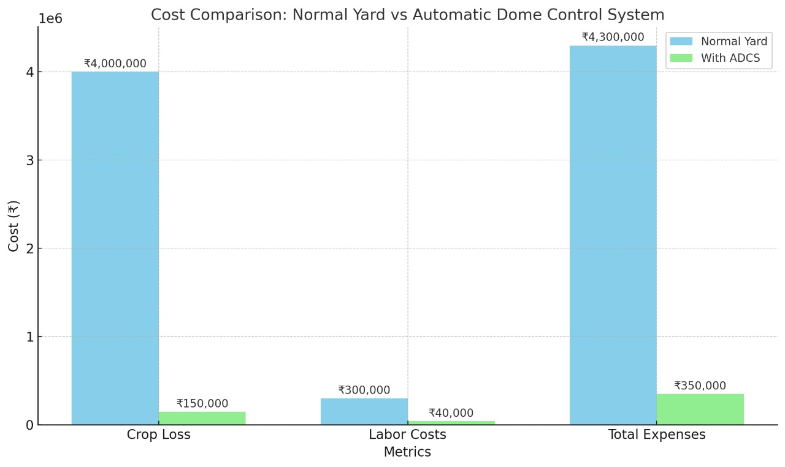

Slide 10
Getting Real-Time Weather Data From API
Fetches real-time weather data using the OpenWeatherMap API.
Processes weather conditions using a predefined list of rain-related events.
Decides whether to open or close the dome.

Slide 11
SYSTEM DESIGN
Input Components
DHT11 Sensor: Measures temperature and humidity levels.
Rain Sensor: Detects rainfall to close the dome.
Fire Sensor: Identifies fire hazards or high temperatures to trigger safety mechanisms.
Processing Unit
Arduino Uno:
Collects and processes data from sensors.
Executes control logic to manage dome operations.
Communicates with the GSM module to send alerts.
Communication Module
GSM Module: Sends SMS alerts to the user for critical events (e.g., rain detection, fire alerts, or abnormal conditions).

Slide 12
Output Components
Buzzer: Provides audible alerts during fire detection or system malfunctions.
Actuators: Control motors for dome opening, closing, and orientation.
Power Supply
Powers the Arduino Uno, sensors, GSM module, buzzer, and actuators using a regulated power source (mains supply or battery backup).

Slide 13
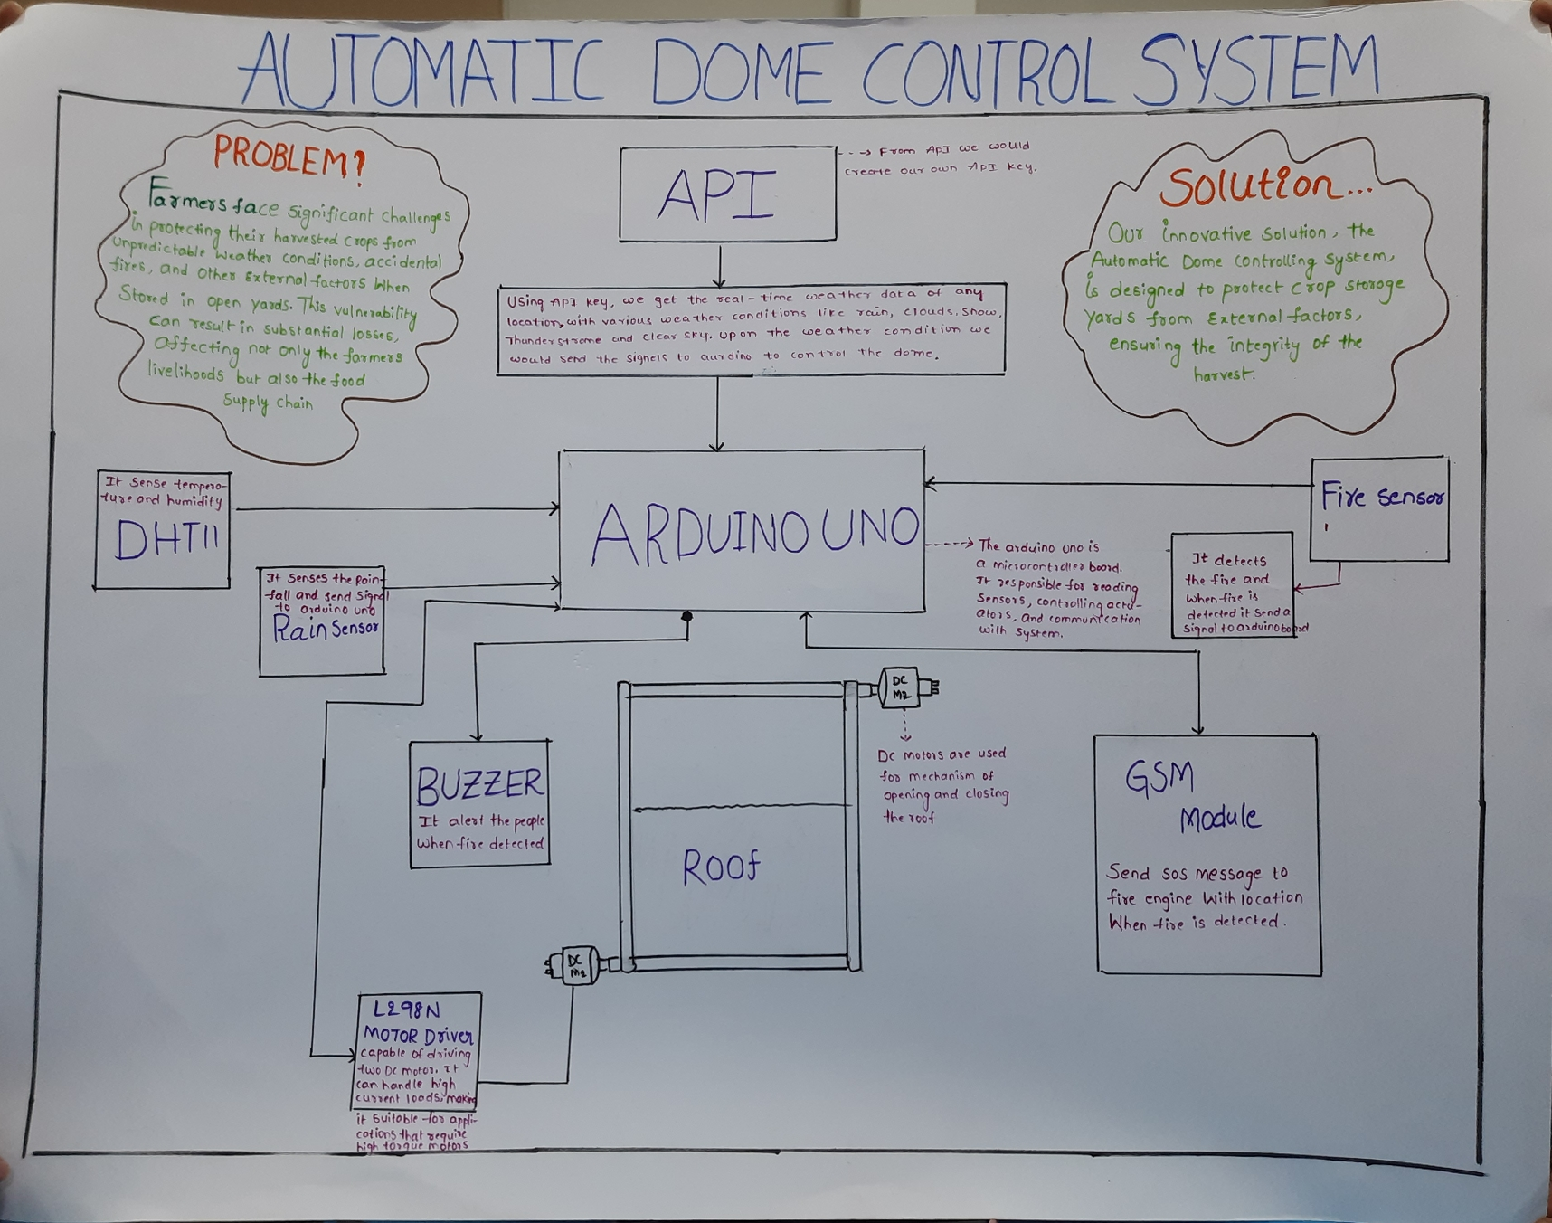
BLOCK DIAGRAM

Slide 14
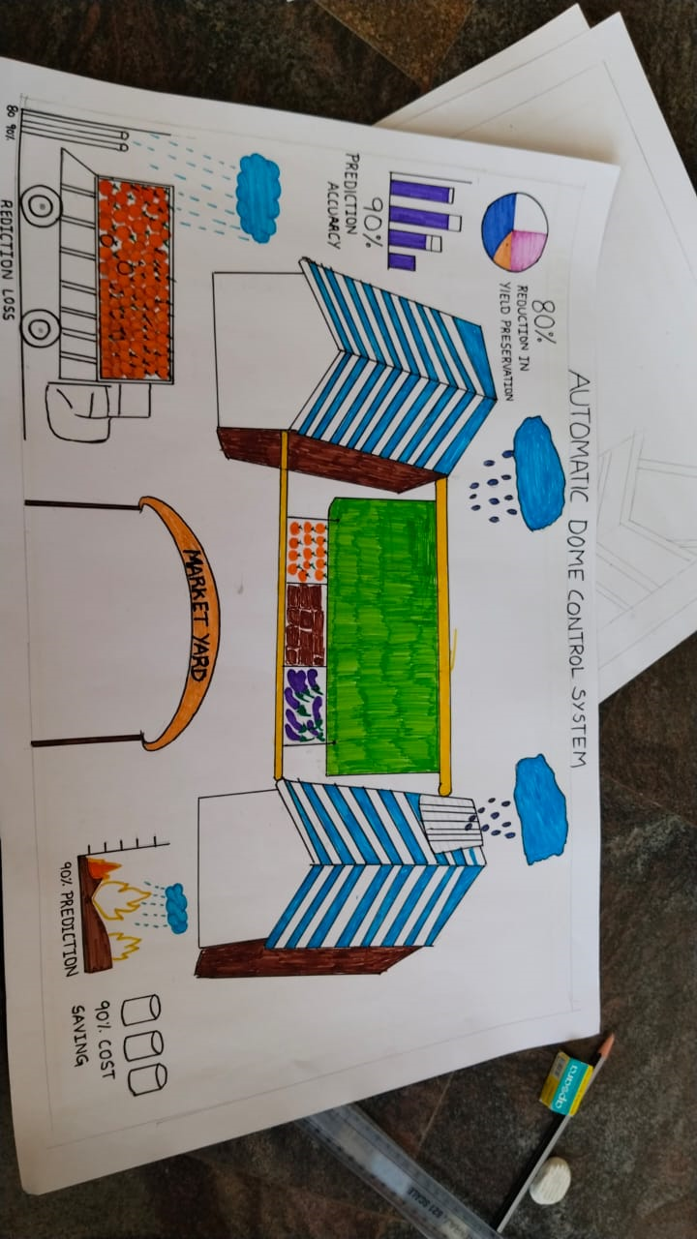


Slide 15
WORKING MECHANISM
Sensor Data Collection
DHT11 Sensor: Monitors temperature and humidity.
Rain Sensor: Detects rainfall and signals the system to close the dome.
Fire Sensor: Identifies fire hazards or excessive heat and triggers safety alerts.
GPS Sensor: Tracks the system’s real-time location for monitoring purposes.
Data Processing
The Arduino Uno microcontroller collects sensor inputs and processes them based on predefined conditions.
Control logic determines actions such as opening/closing the dome, triggering alarms, or sending alerts.
Decision Execution
Actuators: Motors are activated to open or close the dome based on sensor input.
Buzzer: Sounds an alarm when fire is detected or abnormal conditions occur.
Alerts and Communication

Slide 16
The GSM Module sends SMS alerts to the user when critical events occur:
Rain detected (dome closed).
Fire or high temperature detected (alert and alarm triggered).
Location monitoring through GPS data.
User Interaction (Optional)
Manual overrides or status updates can be communicated via the GSM module or control panel.
System Workflow
Step 1: Sensors gather real-time data.
Step 2: Arduino processes the data and applies the control logic.
Step 3: Appropriate outputs (actuators/buzzer/alerts) are triggered.
Step 4: User is notified via SMS alerts for critical events.

Slide 17
SOFTWARE IMPLEMENTATION
The software implementation of the Automatic Dome Control System is carried out using the Arduino IDE to program the Arduino Uno microcontroller. The logic is developed in C/C++, which processes sensor inputs and executes control decisions. Sensor data from the DHT11 (temperature and humidity), rain sensor, fire sensor, and GPS module are continuously read and analyzed. Predefined threshold values are set for conditions like temperature, humidity, rain detection, and fire hazards. Based on this data, the microcontroller triggers actions such as activating actuators to open or close the dome and turning on the buzzer for alerts.
For communication, the GSM module is programmed to send real-time SMS alerts to users when critical conditions like rain, fire, or abnormal temperature are detected. The GPS module is configured to provide the dome's location, ensuring continuous monitoring. The software ensures smooth operation through an efficient decision-making algorithm that prioritizes safety and automation. Testing and debugging are performed in the Arduino IDE environment to ensure reliable system performance.

Slide 18
HARDWARE IMPLEMENTATION
The Automatic Dome Control System hardware is built around the Arduino Uno microcontroller, which serves as the brain of the system. The microcontroller interfaces with various sensors, including the DHT11 sensor for measuring temperature and humidity, the rain sensor for detecting rainfall, and the fire sensor for identifying fire or high-temperature conditions. The GPS module is used for real-time location tracking of the dome. These sensors are connected to the input pins of the Arduino, allowing the system to continuously monitor environmental conditions.
The system also includes actuators (such as motors) to control the opening and closing of the dome, which are powered through relay modules or motor drivers connected to the Arduino. The buzzer is integrated to provide audible alerts during fire detection or system errors.

Slide 19
For communication, the GSM module is used to send SMS alerts to the user regarding important events such as rain detection, fire hazard, or unusual system activity. Power is supplied to the entire system through a stable power supply unit, ensuring the Arduino, sensors, actuators, and GSM module function reliably.
All components are interconnected on a breadboard or a custom PCB to ensure a compact and efficient design. The hardware setup is designed for easy integration and testing, allowing for the automation of the dome control system.

Slide 20
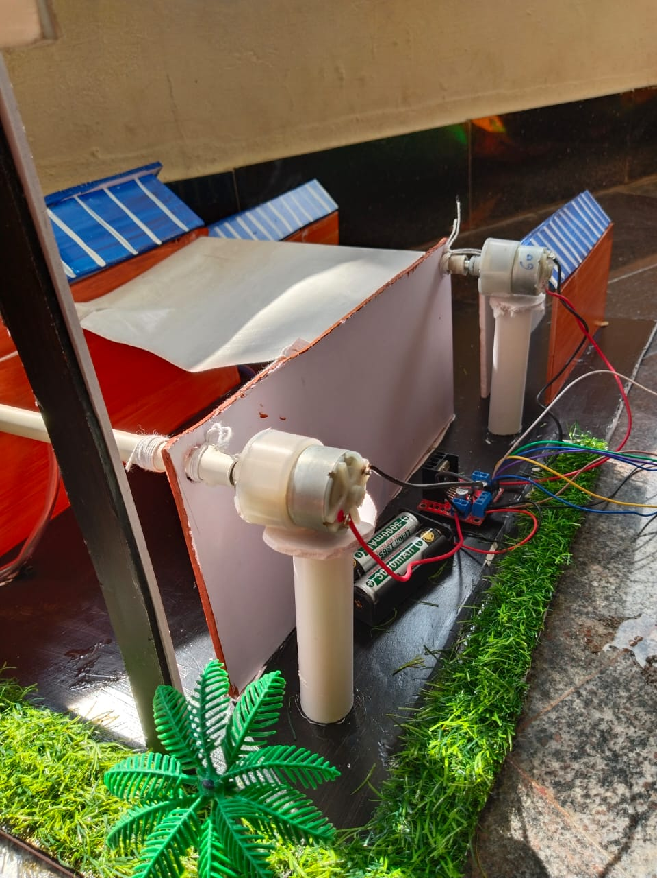
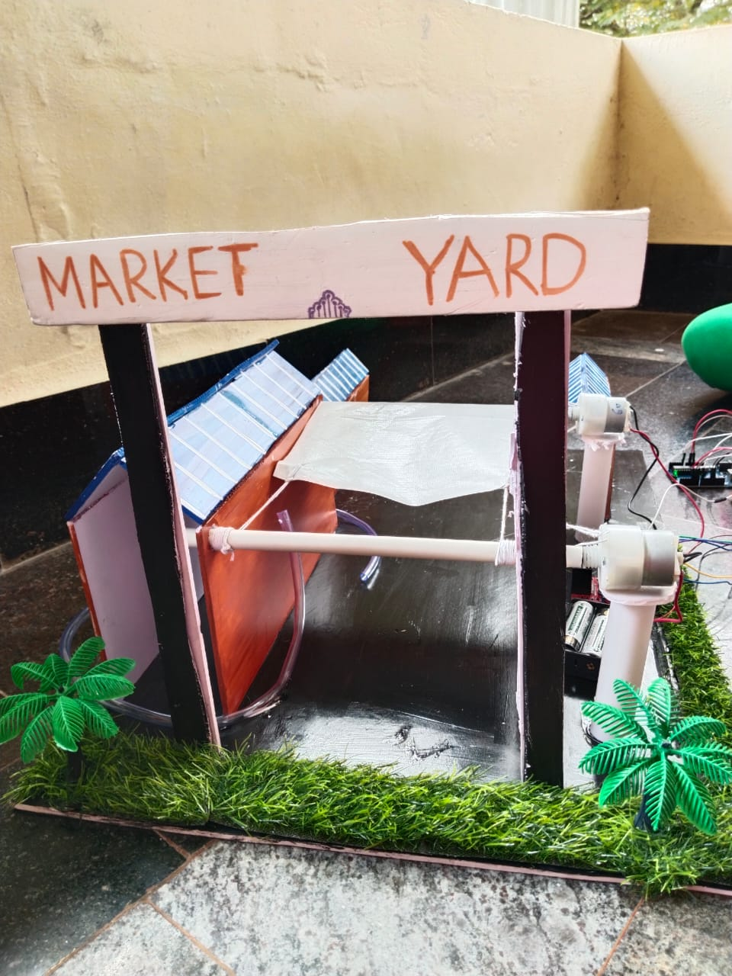
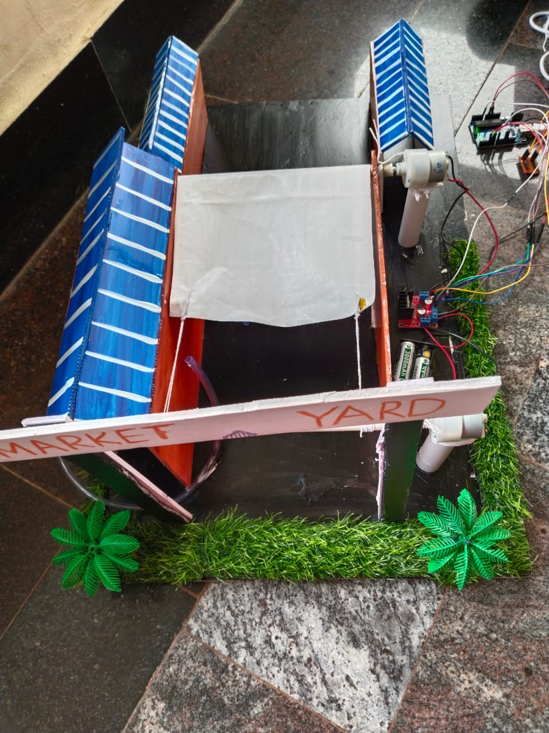
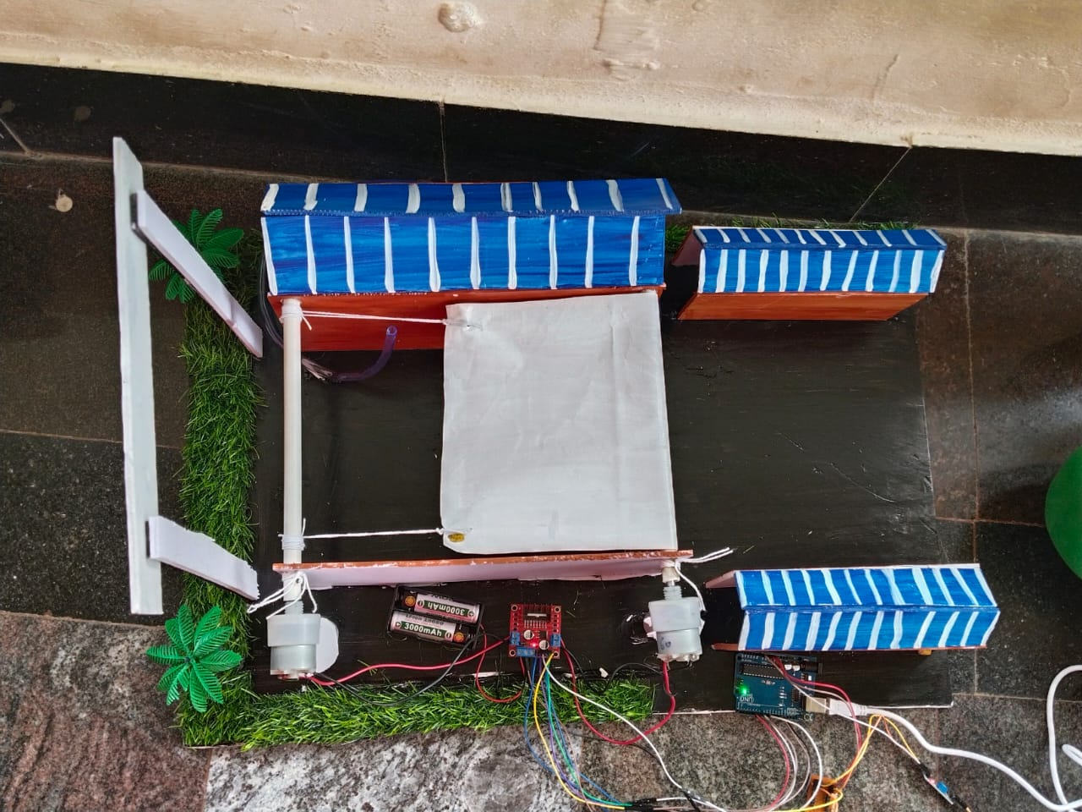
RESULTS

Slide 21
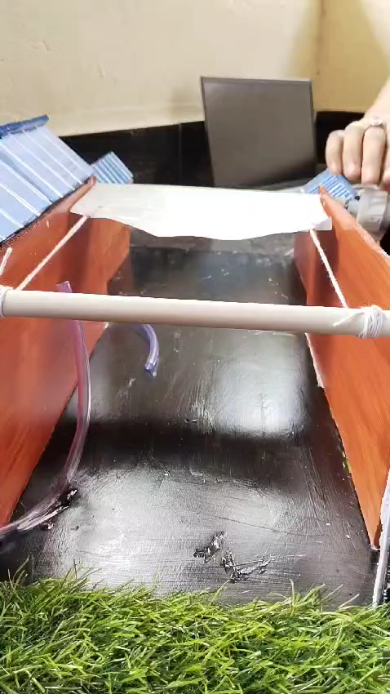

Slide 22
FUTURE ENHANCEMENTS
Integration with Smart Home Systems
The system can be enhanced by integrating with existing smart home platforms (e.g., Google Home, Amazon Alexa), allowing users to control the dome using voice commands or through smartphone apps.
Weather Forecast Integration
By incorporating weather forecast data from the internet, the system could anticipate conditions like rain or storms and take preemptive actions, such as closing the dome in advance to protect the structure.
Advanced Sensors
Incorporating additional sensors like wind speed or solar radiation sensors could further optimize the dome's operations, adjusting based on environmental conditions like high winds or sunlight intensity.

Slide 23
Energy Efficiency Improvements
The use of solar panels could power the system, making it more eco-friendly and reducing the overall energy consumption by powering the sensors and microcontroller through renewable energy.
Machine Learning for Predictive Control
Implementing machine learning algorithms could enable the system to predict environmental changes based on historical data, improving decision-making for dome operation over time.
Real-Time Video Monitoring
Adding camera systems or integrating with drone technology for remote monitoring of the dome structure can provide real-time visuals to ensure everything is functioning properly, especially in areas with challenging access.
Enhanced Communication Protocols
Using IoT protocols (like MQTT or HTTP) for real-time data sharing with cloud platforms or mobile apps, making remote monitoring and control even more efficient.

Slide 24
CONCLUSION
The Automatic Dome Control System efficiently automates dome operations using sensors (DHT11, rain, fire, GPS), the Arduino Uno, and communication modules like GSM. It ensures safety, protection, and real-time monitoring by responding dynamically to environmental conditions. The system reduces manual effort, improves reliability, and can be enhanced with IoT and predictive controls for smarter automation in the future.

Slide 25
THANK YOU

